Slide 1
Twitter Sentiment Analysis
Brand Study at SXSW 2011

Slide 2
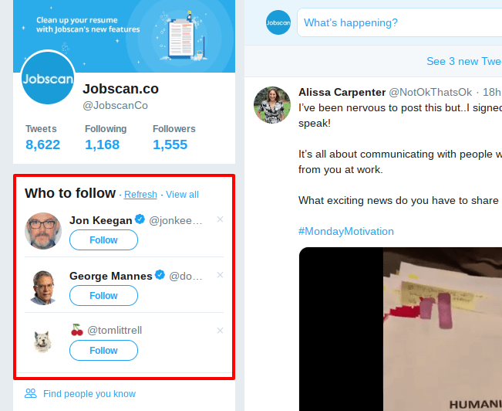
Twitter: EXPRESS your VIEWS IN limited characters
A platform that allows one to express their views in limited characters. 140 on 2017, now increased to 280.
A unified platform for a range of users - business leaders, politicians, celebrities, artists, bloggers and journalists etc
Key features – Number of tweets, re-tweets (RT), followers, following, verified / non verified profiles, hashtags and trends.
Speciality – A crisp message, delivered quickly, reaches a vast audience in no time.
Social Media Management has become an integral part of businesses today.

Slide 3
Problem Statement
As a part of WittyWicky Inc, we are identifying the people’s opinion expressed on twitter about a brand/product as positive, negative or a neutral sentiment.
This would help the business stakeholders to:
Gain competitive insights on new / trending / most sought after product features
Gauge scope for product enhancement / improvement
Understand marketing campaign success ratio
Design better user engagement strategies

Slide 4
Why Solve This problem?
The business can stay on top of new product features in the market.
Develop a robust & improved product.
Plan better marketing campaigns basis the success metrics, identify top influencers and collaborate for brand promotion.
Posts, once sorted sentiment-wise, will help the organization design content strategy using top keyword and develop a healthy customer engagement strategy.
Notes:
Multiplier effect of retweets and shares on social media can increase the reach/spread the word (positive or negative) enormously in a short span of time
In today’s world there are jobs for online social reputation managers.
Sentiment Analysis by data science can be a very good online reputation management
An immediate positive resolution on any current or semi current issue is more likely to turn a critic into a fan. = time is money.

Slide 5

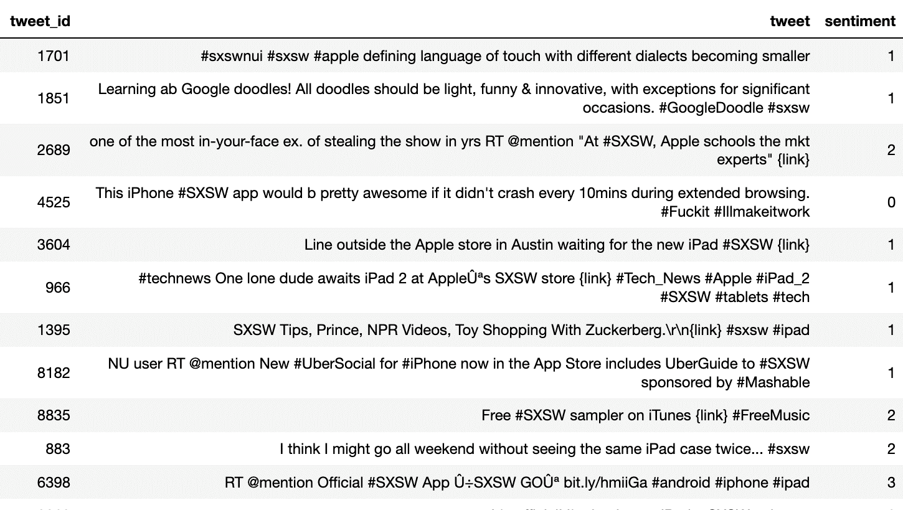
Data
Features & Target
Tweet: Textual data from twitter.com, specifically from audiences at SXSW -2011.
Sentiment: Labelled target with Sentiment classes:
0: Negative
1: Neutral
2: Positive
3: Can’t Tell

Slide 6
Exploratory data analysis
Findings and Insights

Slide 7
Data Cleaning
Beautiful Soup – to removes HTML encodings
Regular Expressions to find repeated patterns
Python’s Strings for Case and Spellings
Stop-words Removal for better information

Slide 8
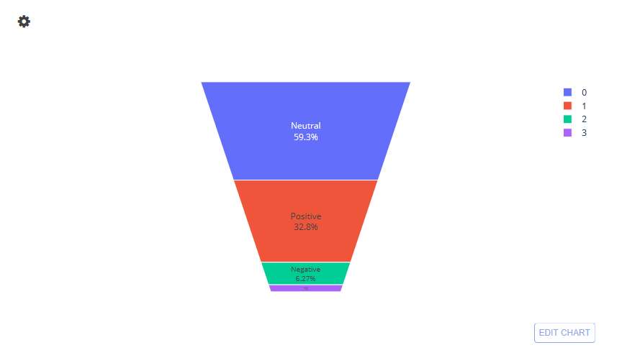
target Distribution
Funnel Chart of Sentiment Distribution in Tweets

Slide 9
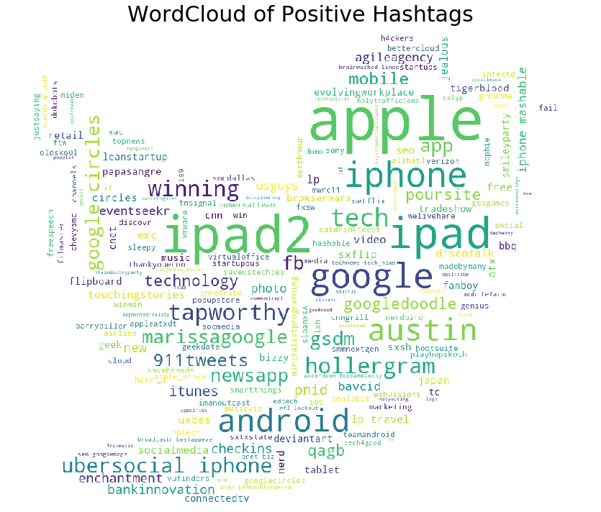
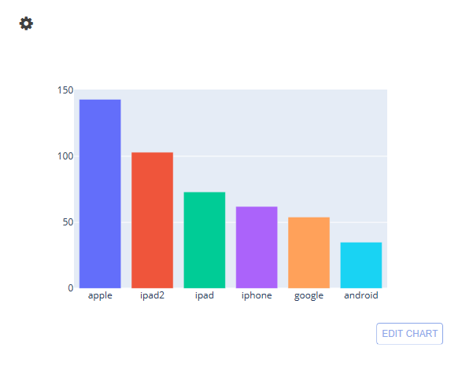
#Hashtags – Positive Tweets
WordCloud of hashtags for positively labelled tweets
Bar Graph of hashtags for positively labelled tweets

Slide 10
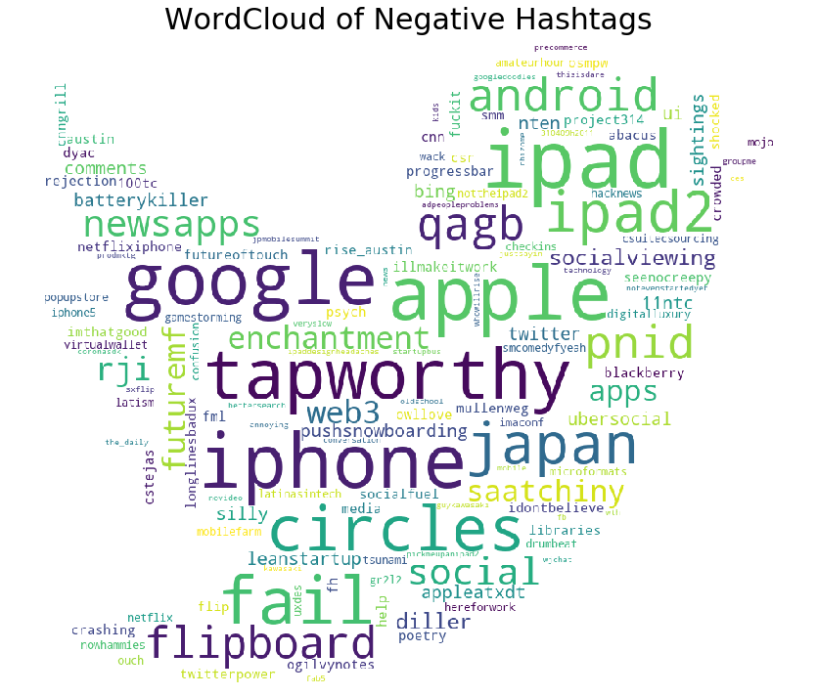
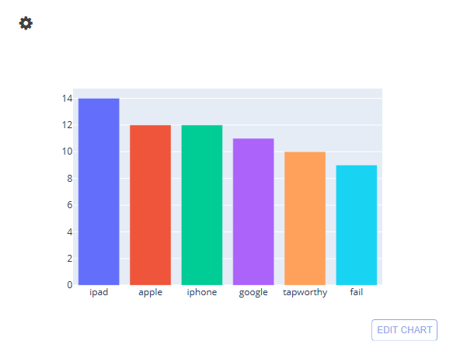
#Hashtags – Negative tweets
WordCloud of hashtags for negatively labelled tweets
Bar Graph of hashtags for negatively labelled tweets

Slide 11
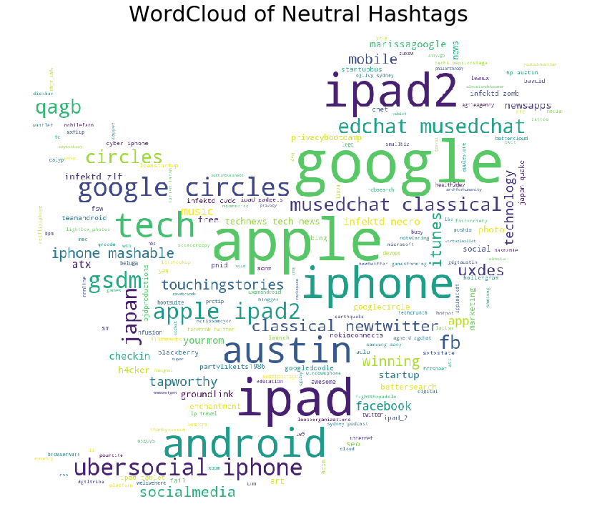
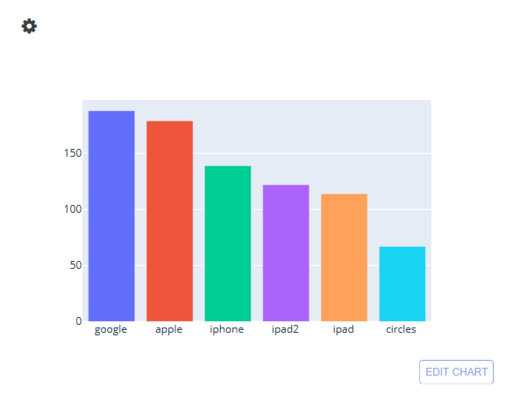
#Hashtags – Neutral tweets
WordCloud of hashtags for neutral labelled tweets
Bar Graph of hashtags for neutral labelled tweets

Slide 12
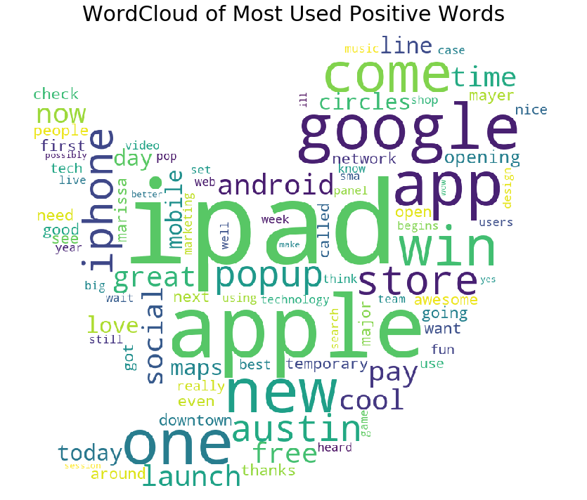
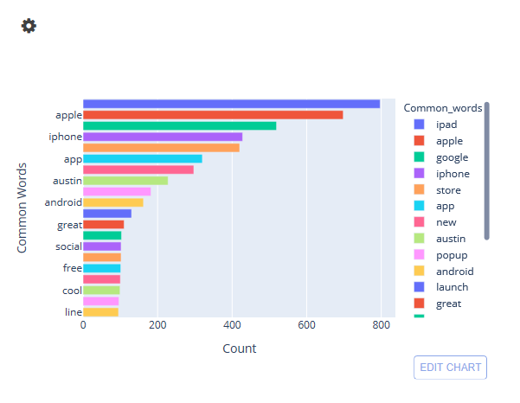
Unigrams – Positive Tweets
WordCloud for unigrams for positively labelled tweets
Bar Graph of unigrams for positively labelled tweets

Slide 13
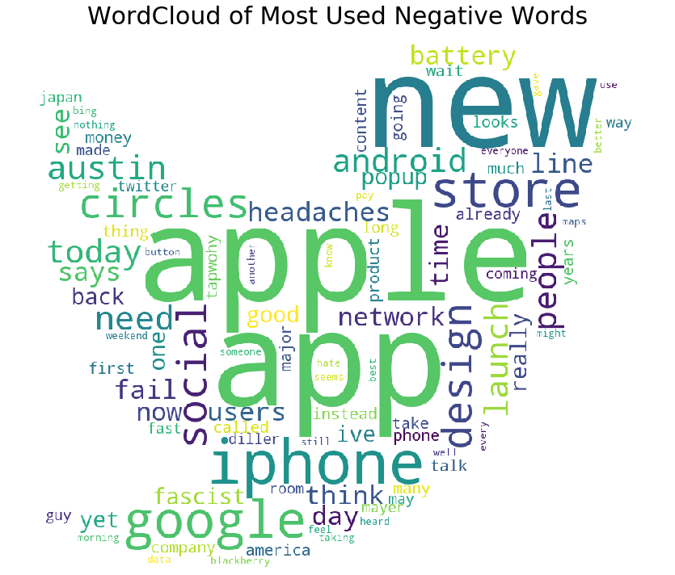
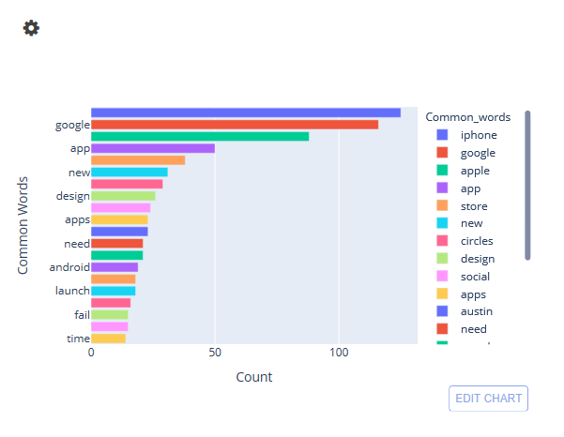
Unigrams – Negative Tweets
WordCloud for unigrams for negatively labelled tweets
Bar Graph of unigrams for negatively labelled tweets

Slide 14
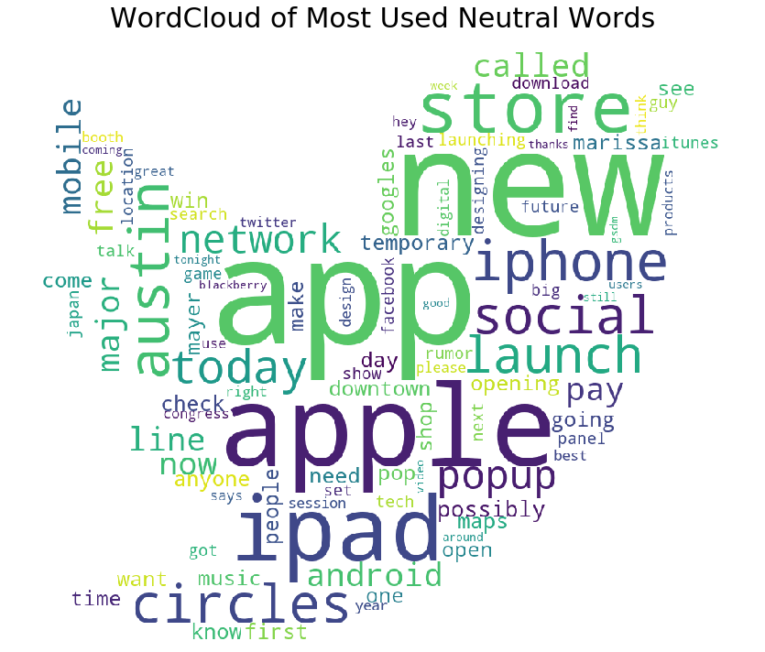
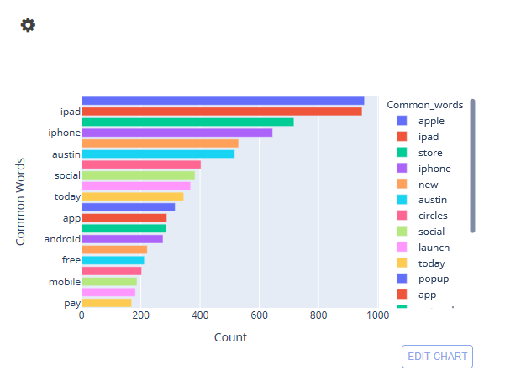
Unigrams – Neutral Tweets
WordCloud for unigrams for neutral labelled tweets
Bar Graph of unigrams for neutral labelled tweets

Slide 15
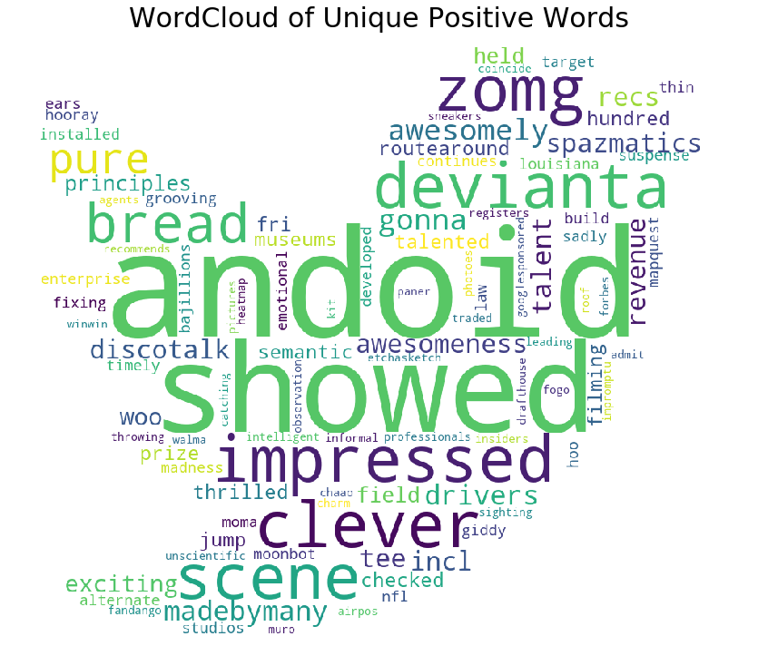
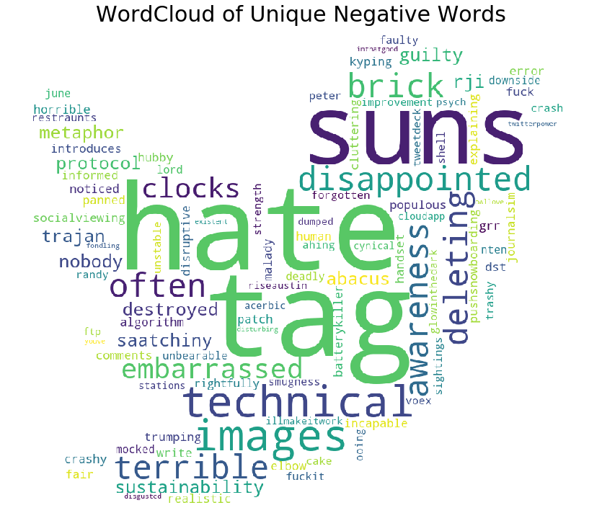
unigrams

Slide 16
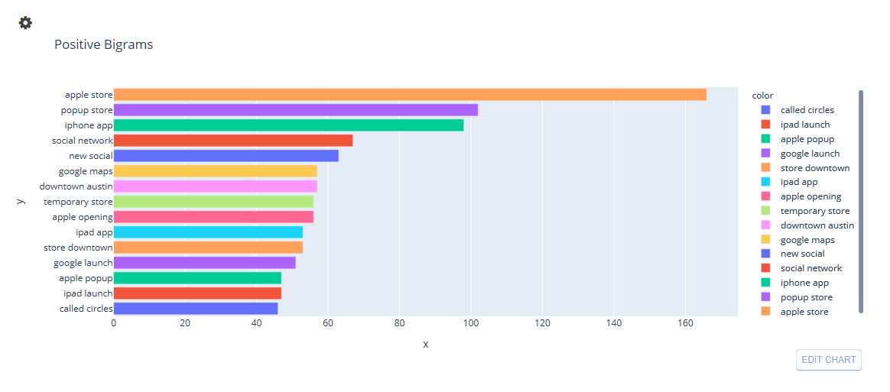
Bigrams - Positive

Slide 17
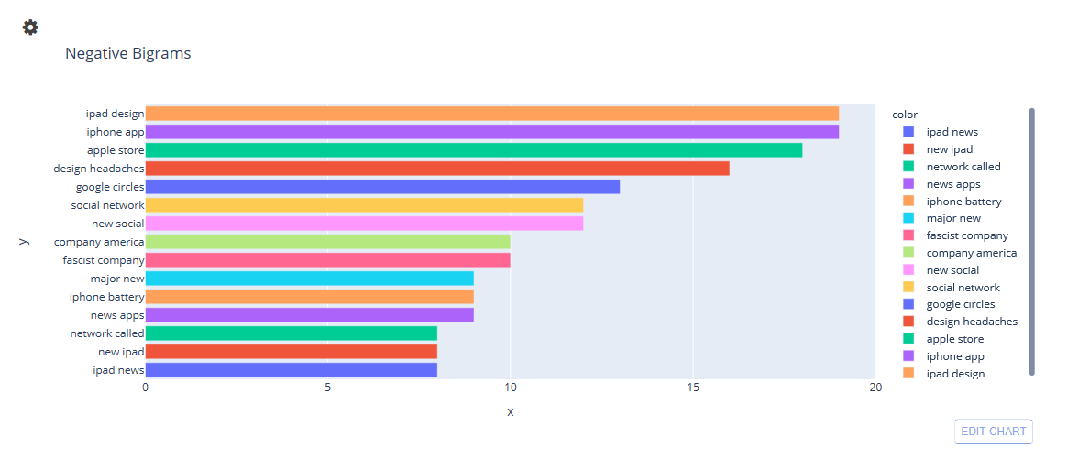
Bigrams - Negative

Slide 18
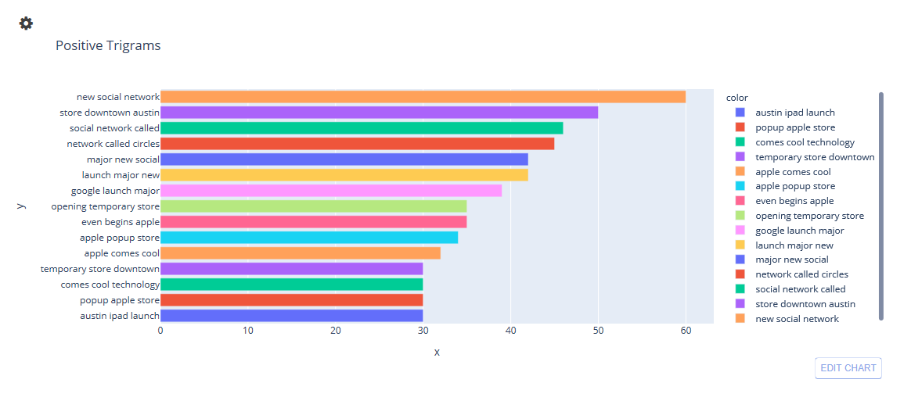
Trigrams - Positive

Slide 19
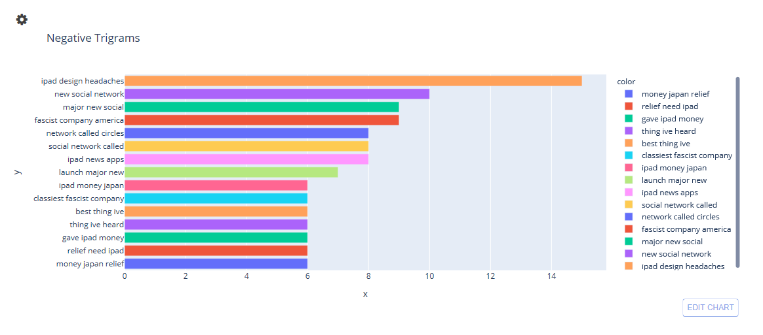
Trigrams - negative

Slide 20
Identifying brands in tweets
What?
Identification of a brand in a tweet – Direct and Indirect
Trending Brands in the SXSW event – What is the talk of the town?
Why?
Brands that stood out with more positive impressions
Brands that failed to make a presence
How?
Spacy’s NER parsing to generate ‘ORG’ tags
Eyeballing data to classify products to the generated ORG

Slide 21
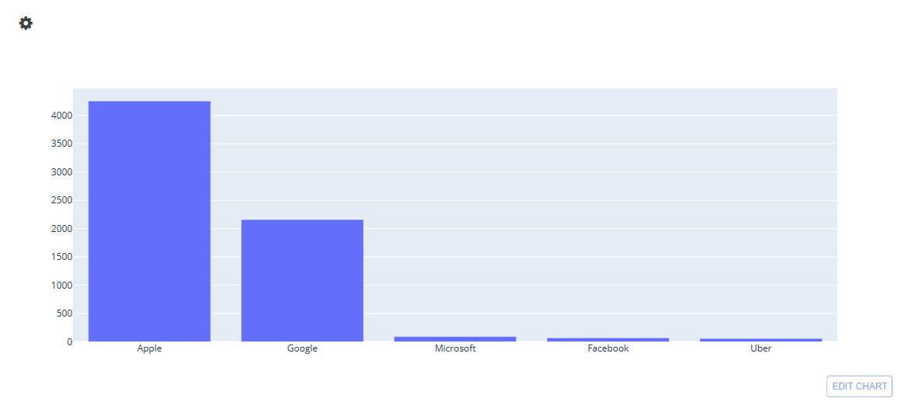
Identifying brands in tweets

Slide 22
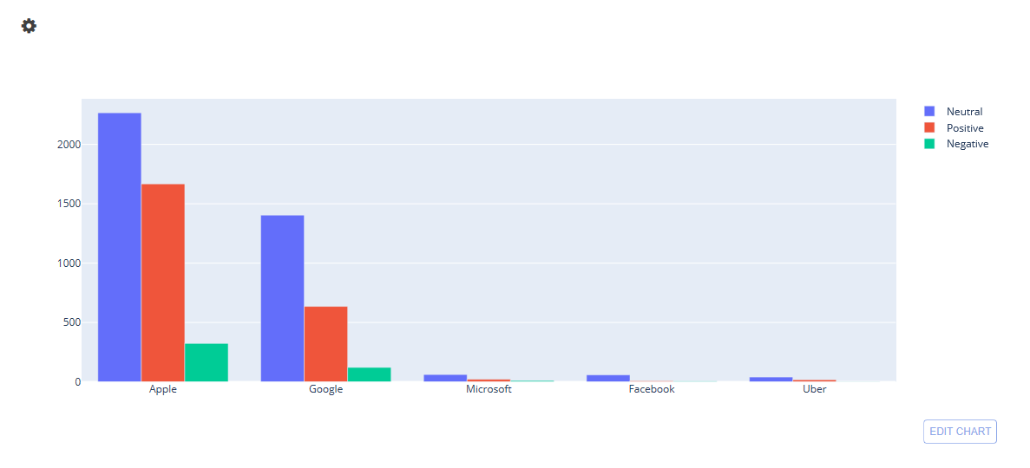
Identifying brands in tweets

Slide 23
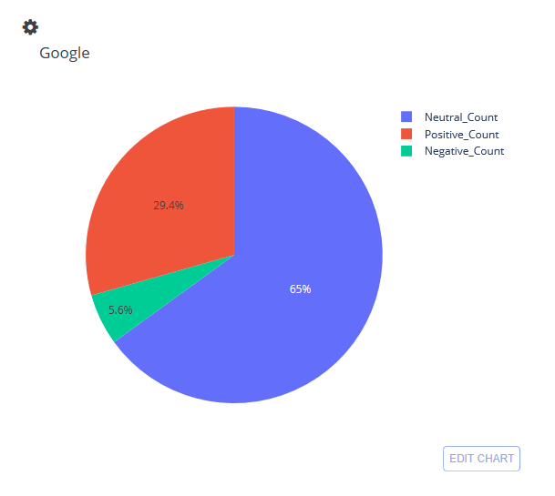
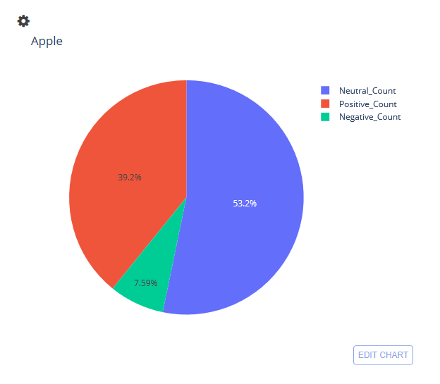
Sentiment distribution OF BRANDS

Slide 24
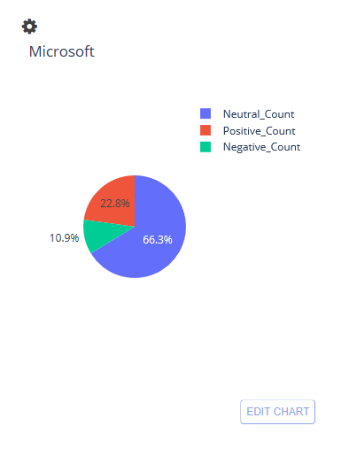
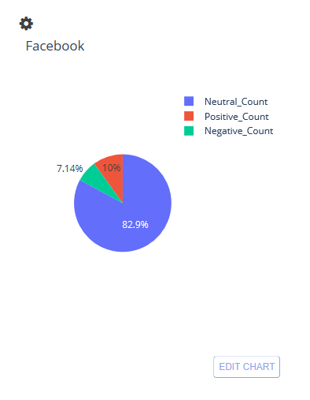
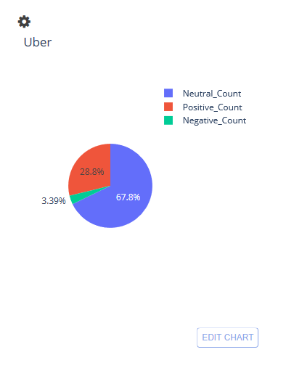
Sentiment distribution OF BRANDs

Slide 25
Pipeline
Data Pre-processing and Preparing for Models

Slide 26
pipeline
Input Text – Tweets
Tokenization
Lemmatization
Feature Engineering
Training the model
Predicting the Sentiment
Text Cleaning
-

Slide 27
Data Pre-Processing
Text Cleaning
Gensim’s simple_preprocess : Handles punctuations, special characters, and removes accent marks
Emoticon Handling : Replaces emoticons with text they represent
Tokenization
Sentences split into separate words
Stop-words Filtering
Removes Prepositions, Conjunctions
Negation words such as ‘did not’, ‘could not’, ‘would not’ were excluded as they convey meaning to sentiments
Lemmatization
Reduces inflectional forms of a word to a common base form.
Keeps the meaning of the words, such as saw remains either see or saw (noun or verb)

Slide 28
Feature engineering
Topic Modelling
Gensim’s LDA model to generate Dominant Topics
TextBlob Sentiment Polarity
TextBlob to assign Polarity Scores
Transformation into Feature Vectors
TFIDF Vectorizer to convert words to Vectors

Slide 29
Data Modelling
Training and Prediction

Slide 30
Models
Model | Test Score | Validation Score | Platform Score
Logistic Regression | 0.638 | 0.641 | 0.615
Random Forest | 0.667 | 0.644 | 0.616
Multinomial NB | 0.564 | 0.582 | 0.563
LinearSVC | 0.651 | 0.651 | 0.6380
SVC | 0.667 | 0.677 | 0.645

Slide 31
TUNED MODELS
Model | Score | Platform Score
Random Forest max_depth =30 min_sample_leaf= 1, min_sample_split = 2, n_estimators = 1200 | 0.661 | 0.6482
XGB n_estimators=500, max_depth = 5, gamma = 0, learning rate = 0.05 | 0.646 | 0.641
SVC C=1, gamma = 1, kernel = ‘rbf’ | 0.671 | 0.6654

Slide 32
TUNED MODELS – WITH Polarity as a feature
Model | Score | Platform Score
Random Forest | 0.668 | 0.636
SVC | 0.690 | 0.671
We additionally ran our best fitted model SVC with Dominant Topics as our next feature.. However we saw a decrease in F1_score both on train and test data.
Our scores with Topic number as a feature were 0.639 (test), 0.641 (val) and 0.60 on platform.

Slide 33
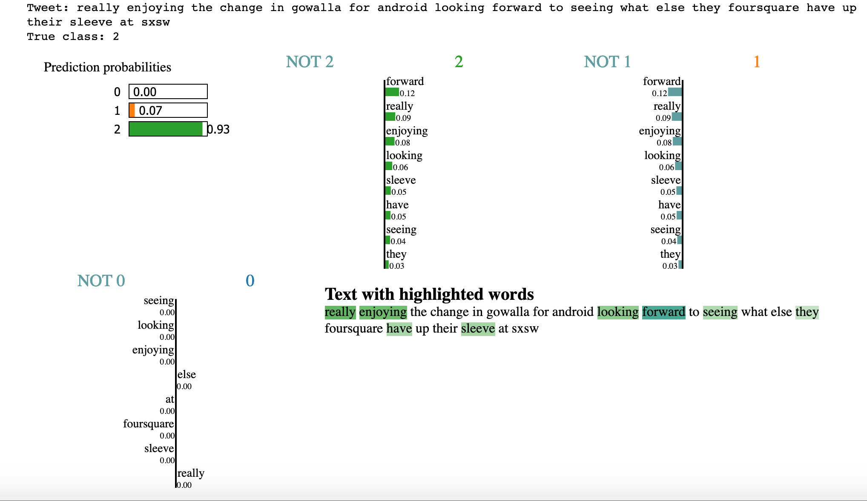
Interpreting Predictions (positive)

Slide 34
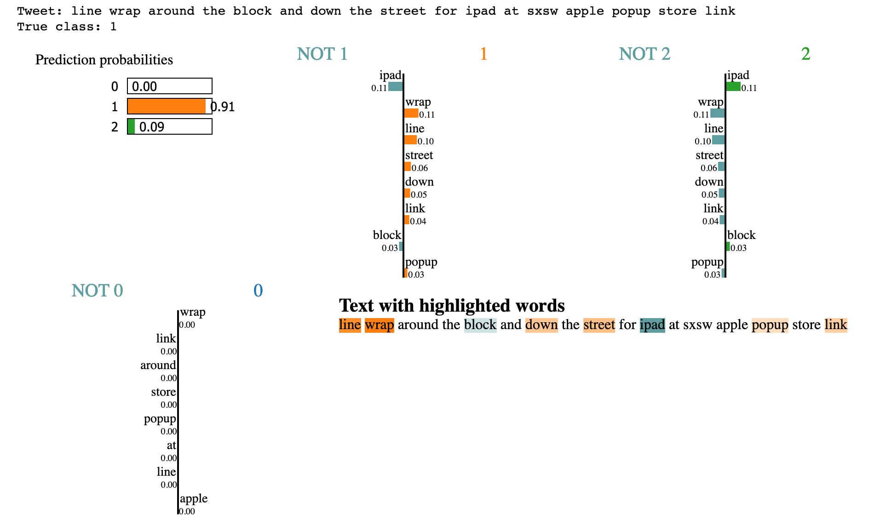
Interpreting Predictions (Neutral)

Slide 35
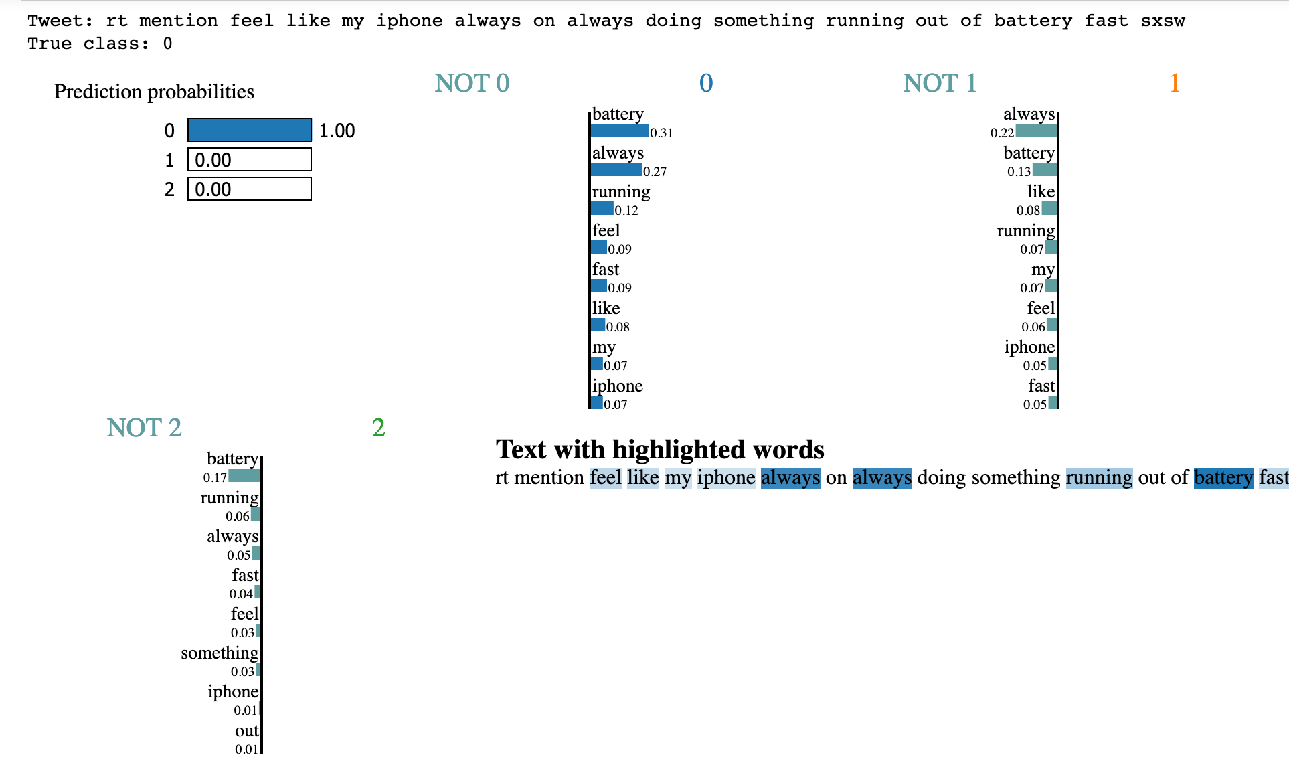
Interpreting Predictions (Negative)

Slide 36
Evaluation metric
F1 Score
Harmonic mean of Precision ( penalizes False Positives) and Recall ( penalizes False Negatives) .
Useful when seeking a balance between Precision and Recall.
Better metric than accuracy for class imbalanced data.

Slide 37
Evaluation metric
Business Use Case - Issue Redressal
Identify negative tweets and not classify them as neutral or positive
Penalize False Negatives
High Recall value
Business Use Case - Customer Retention
Identify keywords from only positive tweets not classify neutral and negative tweets as positives
Penalize False Positives
High Recall value

Slide 38
Insights
Apple and Google are the top 2 brands which are looked up-to when it comes to product innovation and product development.
Diverse product range
Constant tech innovation
Microsoft, Uber and Facebook have a very feeble share of user engagement
Irrespective of the sentiment observed Apple has the highest brand recall
While for apple, iPad2 was received well, google’s maps was the most talked about product for its innovative features
In spite being a popular brand, Apple received criticism for
Battery heating issues
Product pricing (value for money)
On the other hand, Google’s circles was not appreciated well as a social networking product
Observation: Product companies like Apple & Google – higher engagement Vs Service based companies like Facebook & Uber
Notes:
Context for assumptions – The event was planned to host start ups and make the visitors aware about technological advancements (showcasing innovation)

Slide 39
Action Items
Apple need to work on fixing product issues like optimizing battery life, heating issues and product pricing.
Had Apple been active in non profit initiatives, sentiments related to pricing issues (tagged with Japan relief fund etc) could have been addressed positively through a healthy engagement with the audience.
Google could use such analysis along with competitor insights in order to plan future product development better. (Google circles did not see the light of the day)
Notes:
Context for assumptions – The event was planned to host start ups and make the visitors aware about technological advancements (showcasing innovation)

Slide 40
Next steps
Focused studies on product and product features.
User profiling for tailor made marketing and public relation campaigns for various target segments.
Geography based product demand gathering for future product development.

